Slide 1
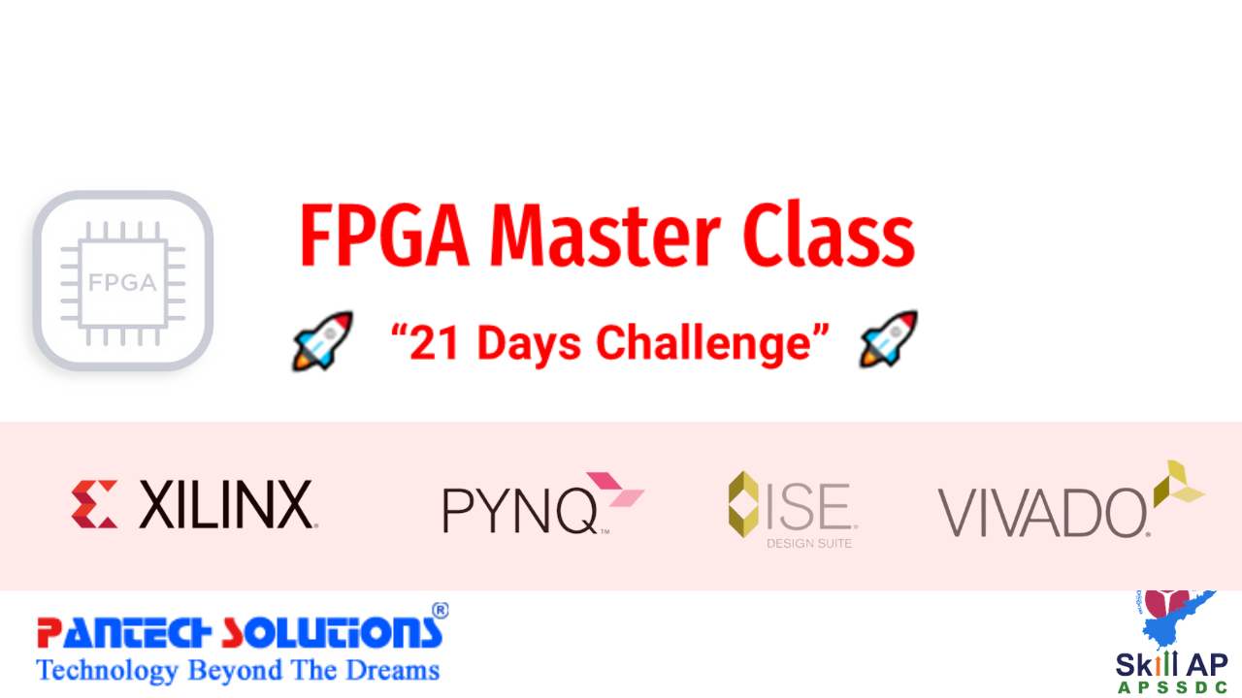

Slide 2
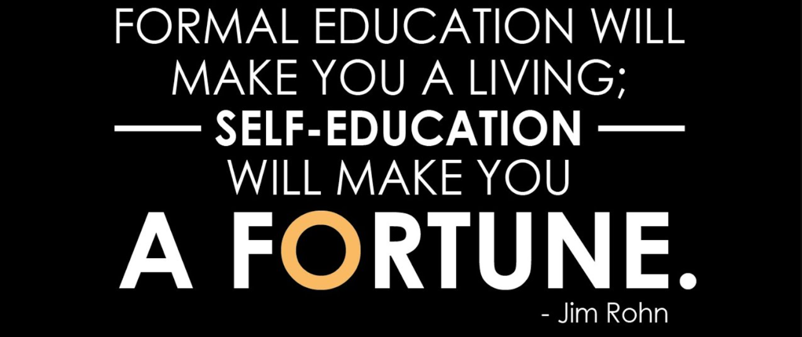
Quote of the Day

Slide 3
What you will Learn? (21 Days Challenge)
Day 1 -Introduction to FPGA
Day 2- Introduction to VHDL , How to create a Project in Xilinx ISE .
Day 3 -Operators and Data Flow Modeling (VHDL)
Day 4 -Structural & Behavioral Modeling
Day 5 -Creating a Test Bench
Day 6 -How to Design a Spartan 6 FPGA Board
🌟🌟🌟

Slide 4
What you will Learn? (21 Days Challenge)
Day 7 -FPGA Programming for Blinking LED ,SWITCH, Relays and Buzzer
Day 8 -UART Programming on FPGA
Day 9 -LCD, SEVEN SEGMENT Programming on FPGA
Day 10 -ADC and DAC Programming on FPGA
Day 11- Bluetooth and Relay Programming -Bluetooth Home Automation using FPGA🌟🌟🌟
Day 12 -Internet of Things using FPGA -Part 1 (Interfacing with WIFI) 🌟🌟🌟

Slide 5
What you will Learn? (21 Days Challenge)
Day 13 -Internet of Things using FPGA -Part 2 (Sending Temperature data to Cloud) 🌟🌟🌟
Day 14 -Motor control using FPGA (PWM ) 🌟🌟🌟
Day 15 -Embedded system Design using FPGA (C Based programming on FPGA)
Day 16 -Median Filter on Spartan 6 FPGA🌟🌟🌟
Day 17- Edge Detection on FPGA🌟🌟🌟

Slide 6
What you will Learn? (21 Days Challenge)
Day 18 -IoT Programming on FPGA using C Language
Day 19 -Debugging with Chip scope PRO🌟
Day 20 -Introduction to Python Programming on FPGA
Day 21 -Yolo object detection on FPGA🌟🌟🌟
---------------------Graduation Day-------------------------

Slide 7
What you will Learn on 30 Days Internship –Extra Bonus
Day 22 -Real time edge detection using ZYNQ FPGA (pynq) 🌟🌟🌟
Day 23 -Real time Moving object detection using ZYNQ FPGA 🌟🌟🌟
Day 24 -Discrete Wavelet Transform using Spartan 6 FPGA(C Language) 🌟🌟🌟
Day 25 -Image Segmentation using Spartan6 FPGA🌟🌟🌟
Day 26 -Introduction to Vivado Design Suite
Day 27 -Implementing LED , UART Using - Vivado Design Suite
Day 28- Machine Learning with Python in PYNQ🌟🌟🌟
Day 29 -OpenCV for Image Processing & Video_processing (PYNQ with Python)-ZYNQ FPGA🌟🌟🌟
Day 30 -Conclusion and Future of VLSI

Slide 8
About pantechsolutions
Manufacturers of Lab equipment's(ECE &EEE) and Sensor Interface
Manufacturer of Brainsense EEG Headset
Reconfigurable Algorithms on AI
Manufacture of AI development Boards
Vision: To help 10 millions students to learn technology
in a easy way

Slide 9


About me
My Primary Expertise
Microcontroller Architecture: 8051,PIC,AVR,ARM,MSP430,PSOC3 DSP Architecture: Blackfin,C2000,C6000,21065L Sharc FPGA: Spartan,Virtex,Cyclone Image Processing Algorithms: Image/Scene Recognition, Machine Learning, Computer Vision, Deep Learning, Pattern Recognition, Object Classification ,Image Retrieval, Image enhancement and denoising. Neural Networks : SVM,RBF,BPN Cryptography :RSA,DES,3DES,Ellipti curve,Blowfish,Diffe Hellman Compilers: Keil,Visual DSP++,CCS, Xilinx Platform studio,ISE, Matlab, Open CV
www.pantechsolutions.net
https://www.linkedin.com/in/jeevarajan/

Slide 10
Why FPGA ?

Slide 11
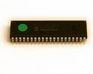

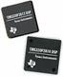
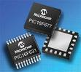
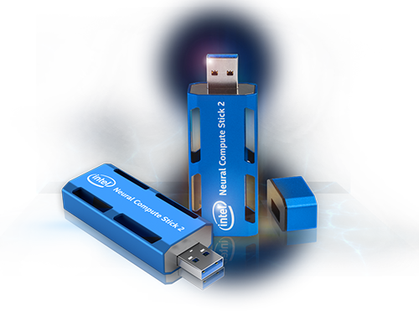
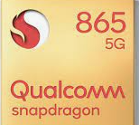
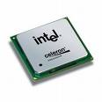
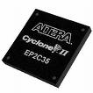
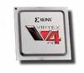
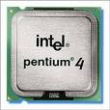
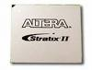
Types of Processors and Controllers
Texas,analog devices,Motorolla,
Dallas,philips
Renesas,freescale,
Texas,Microchip
DSP
Microprocessors/
Microcontrollers (8/16/32)
SOC
QUALCOMM
BROADCOMM
ASIC
GENERAL PURPOSE
PROCESSORS
(CPU Vs GPU)
CPLD/FPGA
INTEL
Xilinx,Altera
Lattice,Actel
Intel,AMD,Nvidia

Slide 12
Microprocessor Basic
CPU
CONTROL
ADDRESS
DATA
BOOT ROM
Used at startup
Instruction (program) ROM
Transducers
Keyboard Screen UART Parallel interface
etc
Data RAM
Microprocessor, must have external peripherals to
Interact with outside world,It is obsolete

Slide 13
Micro controller
CPU
Program Memory
Timers
Data Memory
ADC
UART
Parallel Port
CAN

Slide 14
Basic Features of DSPs
Digital Signal Processor is mathematics on chip.
DSPs usually run applications with hard real-time constraints:
DSPs usually process infinite continuous data streams.
MAC Capability
DSP processors are microprocessors designed for efficient
mathematical manipulation of digital signals.

Slide 15
Why do we need DSP processors?
Microcontrollers are control oriented ,DSP are data path oriented
Use a GPP processor when the following are required:
Large memory.
Advanced operating systems.
Use a DSP processor when the following are required:
Precision
Cost saving.
Smaller size.
Low power consumption.
Processing of signals in real-time.

Slide 16
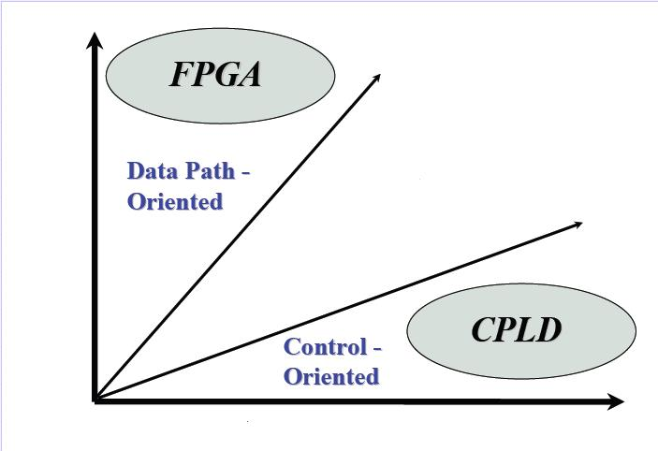
CPLD Vs FPGA

Slide 17
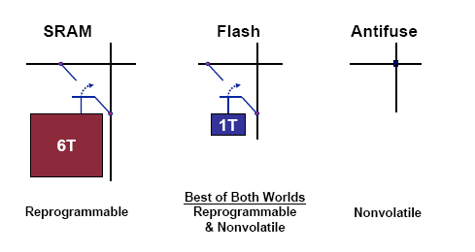
FPGA Technologies

Slide 18
DSP Vs FPGA

Slide 19
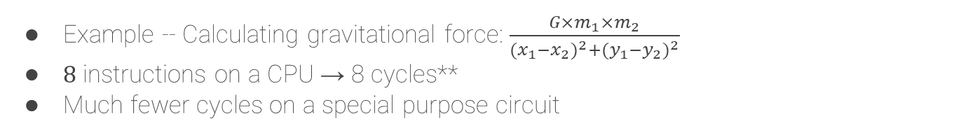
Fine-Grained Parallelism of Special-Purpose Circuits
Example -- Calculating gravitational force: $\frac{G×m_{1}×m_{2}}{{(x_{1}−x_{2})}^{2}+{(y_{1}−y_{2})}^{2}}$
8 instructions on a CPU → 8 cycles**
Much fewer cycles on a special purpose circuit
A = G × m₁
C = x₁ - x₂
E = y₁ - y₂
A = G × m₁ × m₂
B = (x₁ - x₂)²
C = (y₁ - y₂)²
B = A × m₂
D = C²
F = E²
D = B + C
G = D + F
Ret = B / G
3 cycles with compound operations
Ret = B / G
4 cycles with basic operations

Slide 20
When to use DSP in FPGA
Higher Performance
Parallel algorithm implementation
Customizable Design
Optimize for speed and cost
System Integration
Less board real estate
Less chips could mean less system cost

Slide 21
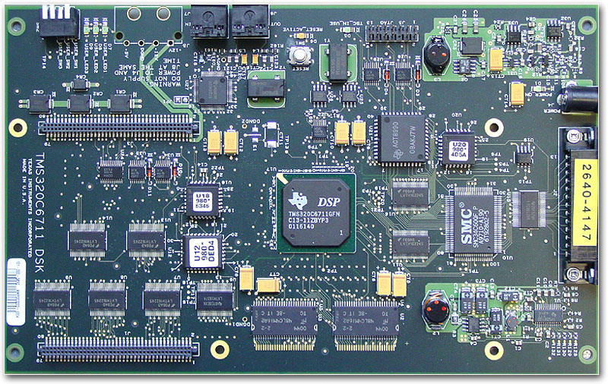
Traditional embedded system design using DSP
Power Supply
Ethernet MAC
CLK
Audio Codec
CLK
GP I/O
Interrupt Controller
Timer
Address Decode Unit
CPU (uP / DSP)
UART
Co- Proc.
LC
Memory Controller
custom IF-logic
CLK
SRAM
SRAM
SRAM
Display Controller
SDRAM
SDRAM

Slide 22
Next Step...
Power Supply
Ethernet MAC
CLK
Audio Codec
CLK
FPGA
GP I/O
Interrupt Controller
Timer
Address Decode Unit
CPU (uP / DSP)
UART
Co- Proc.
LC
Memory Controller
custom IF-logic
CLK
SRAM
SRAM
SRAM
Display Controller
SDRAM
SDRAM

Slide 23
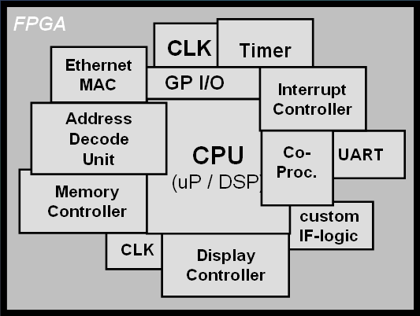
Configurable system on Chip-CSoC
Audio Codec
EPROM
Power Supply
LC
SRAM
SRAM
SRAM
SDRAM
SDRAM

Slide 24
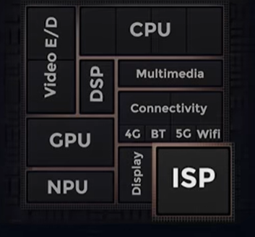
Multicore Processor -SoC
2 or More Independent Processors in 1 Package
Symmetric Multiprocessing
Number of Identical Processors
Common Shared Memory
One Operating System
Asymmetric Multiprocessing
Different Processors, Instruction Sets
Different Operating Systems
Possibly Without Shared Memory

Slide 25
AMP-TI OMAP
Processors Need Not be Identical
Processor Specialization May Increase Performance.
T.I.’s OMAP•General Purpose Processor+Digital Signal Processor(“DSP”)

Slide 26
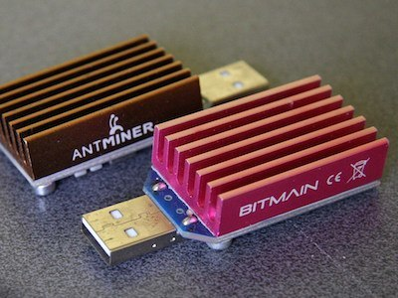
How FPGA Is Different From ASICs
ASIC (Application-Specific Integrated Circuit)
Special chip purpose-built for an application
E.g., ASIC bitcoin miner, Intel neural network accelerator
Function cannot be changed once expensively built
+ FPGAs can be field-programmed
Function can be changed completely whenever
FPGA fabric emulates custom circuits

Slide 27
Comparison
FPGA
ASIC
Cost
SOC
DSP
Micro controllers
Performance

Slide 28
History of FPGA

Slide 29
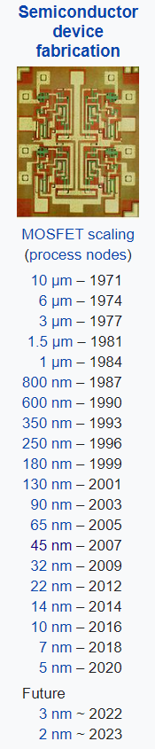
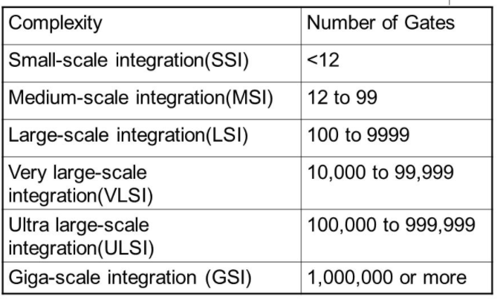
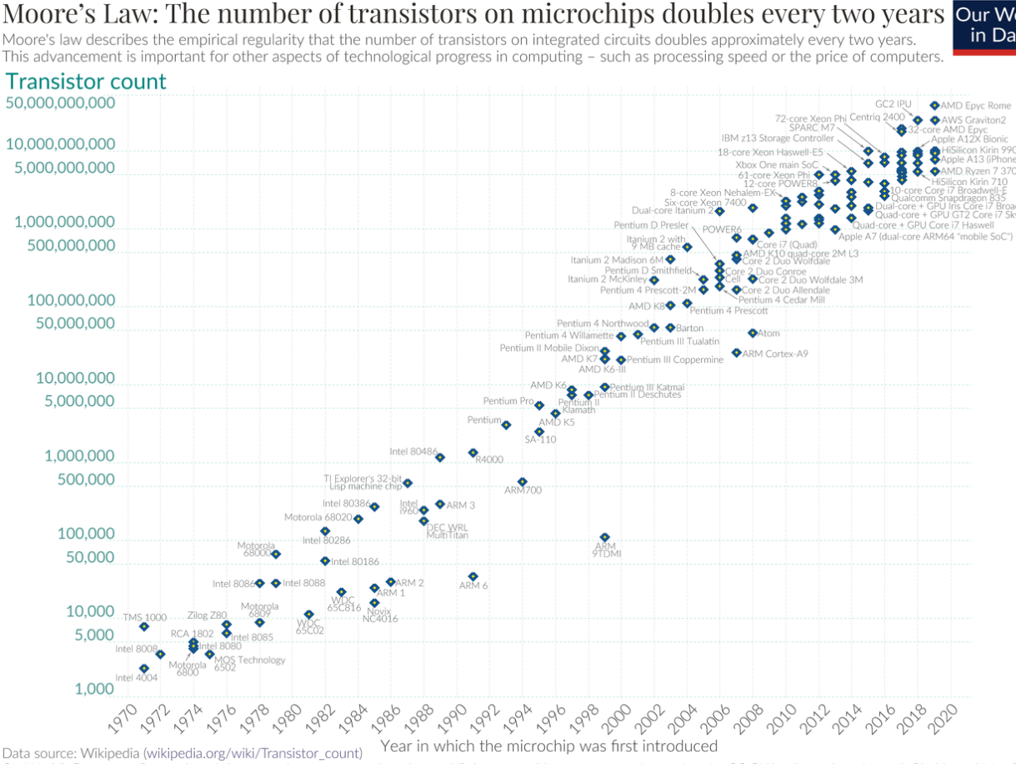
Moore’s Law

Slide 30
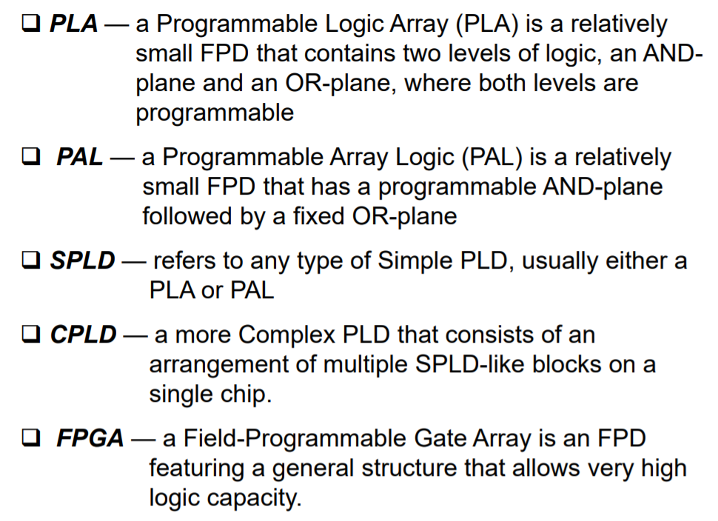
History of FPGA

Slide 31
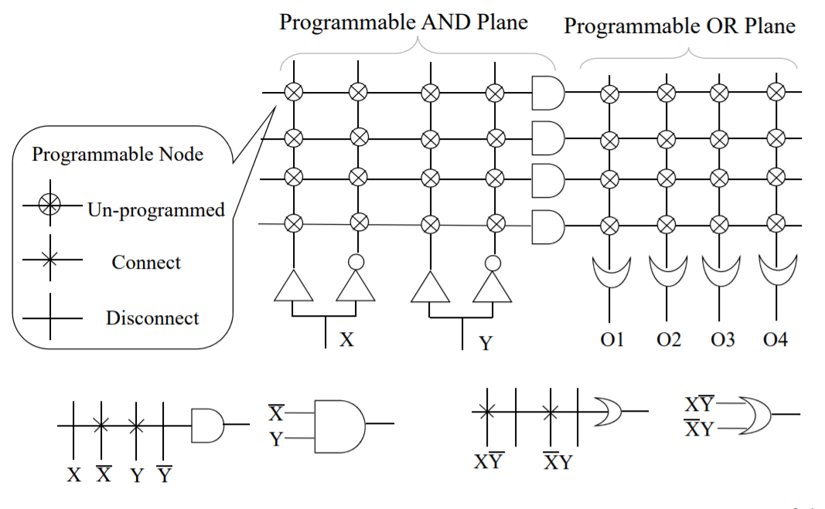
How PLA Works

Slide 32
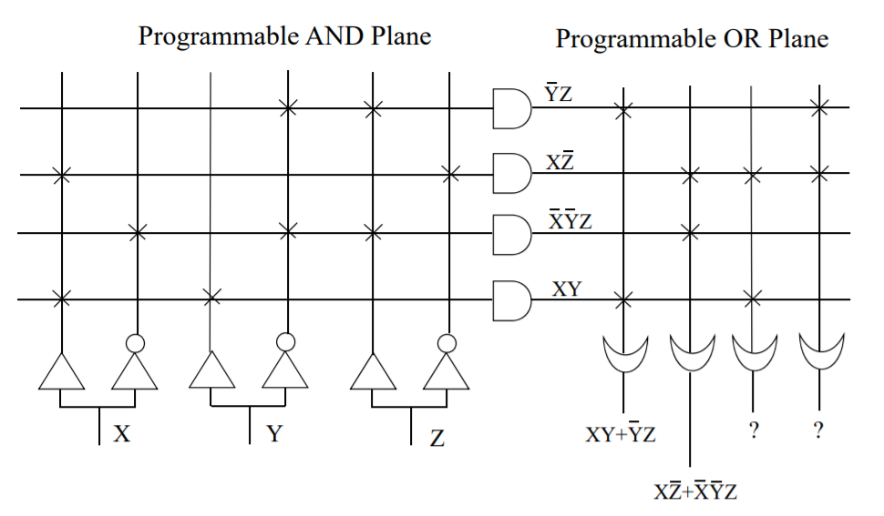
Example of PLA
XY+XZ
YZ+XZ

Slide 33
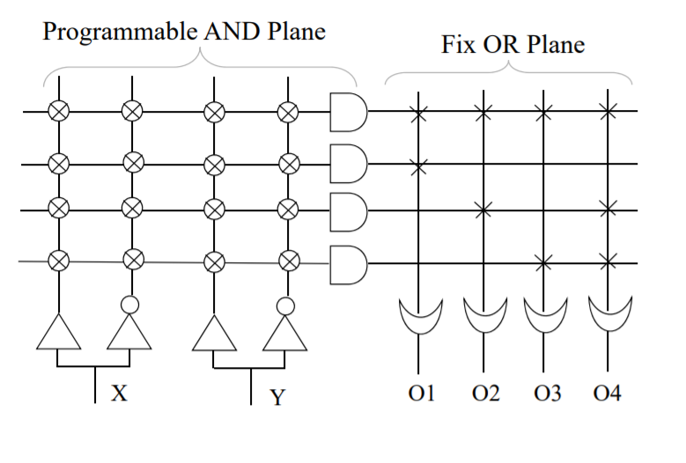
PAL
The PALASM design software (PAL assembler) converted the engineers' Boolean equations into the fuse pattern required to program the part.

Slide 34
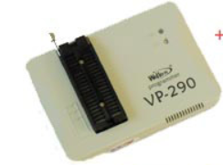
PLD
A PLD is a combination of a logic device and a memory device. The memory is used to store the pattern that was given to the chip during programming.
Silicon antifuses
SRAM
EPROM or EEPROM memory cells
Flash memory
PALASM, ABEL and CUPL are frequently used for low-complexity devices,
while Verilog and VHDL are popular higher-level description languages for more complex devices
CUPL Description Language
CUPL Programmable Logic Description Language is a compiler that converts logic equations into a Fuse map (JEDEC file) for the PLD programmer.

Slide 35
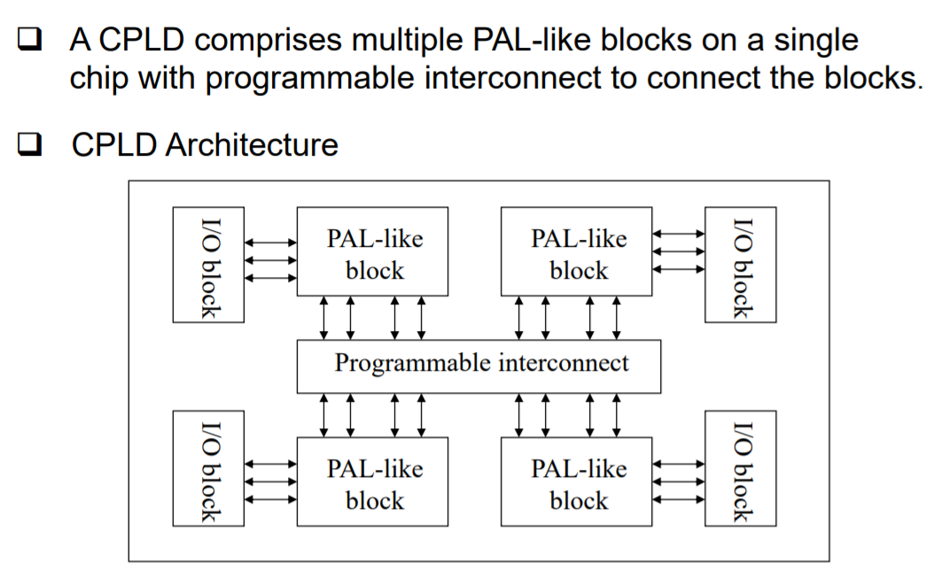
CPLD

Slide 36
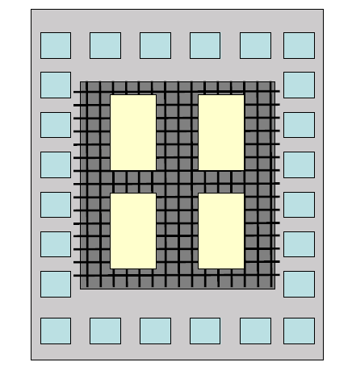
CPLD Architecture
Logic blocks
I/O blocks
Clock routing
Routing matrix

Slide 37
FPGA Architecture
Logic blocks
I/O blocks
Clock routing
Routing matrix
Memory
Multipliers /DSP blocks
Processor core

Slide 38
Basic FPGA Architecture
“Configurable logic block (CLB)”
Programmable
~
I/O block
6-Input
Look-Up
Table
Latch
FF
Ex) 2-LUT for “AND”
Sequential circuit
construction
Input 1 | Input 2 | Output
0 | 0 | 0
0 | 1 | 0
1 | 0 | 0
1 | 1 | 1
Programmable interconnect
CLBs act as gates – Many needed to implement high-level logic

Slide 39
Basic FPGA Architecture – DSP Blocks
“DSP block”
Arithmetic operation provided as efficient ALU blocks
“Digital Signal Processing (DSP) blocks”
Each block provides an adder + multiplier
×
+/-

Slide 40
Basic FPGA Architecture – Block RAM
“Block RAM”
CLB can act as flip-flops
(~1 bit/block) – tiny!
Some on-chip SRAM provided as blocks
~18/36 Kbit/block, MBs per chip
Massively parallel access to data → multi-TB/s bandwidth

Slide 41
Basic FPGA Architecture – Hard Cores
Some functions are provided as efficient, non-configurable “hard cores”
Multi-core ARM cores (“Zynq” series)
Multi-Gigabit Transceivers
PCIe/Ethernet PHY
Memory controllers
Memory
Ethernet
ARM
PCIe

Slide 42
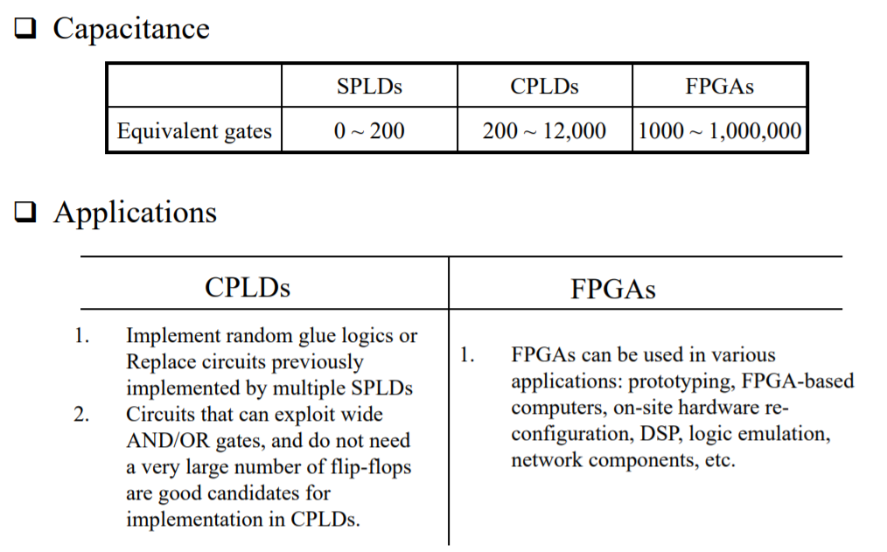
PLD Vs CPLD Vs FPGA

Slide 43
List of Company Manufacturing FPGA
Xilinx
Altera(Intel)
Actel
Lattice

Slide 44
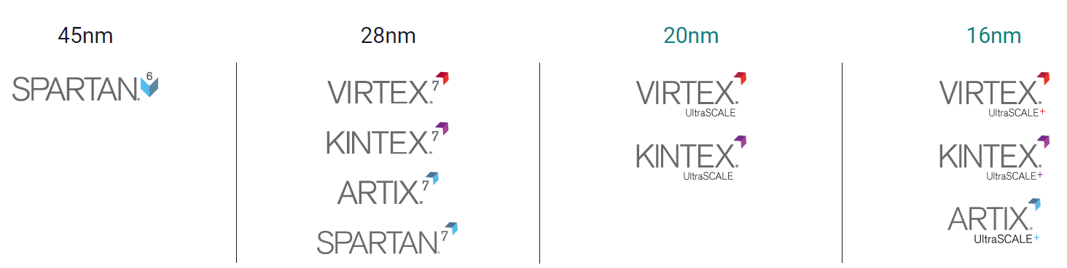
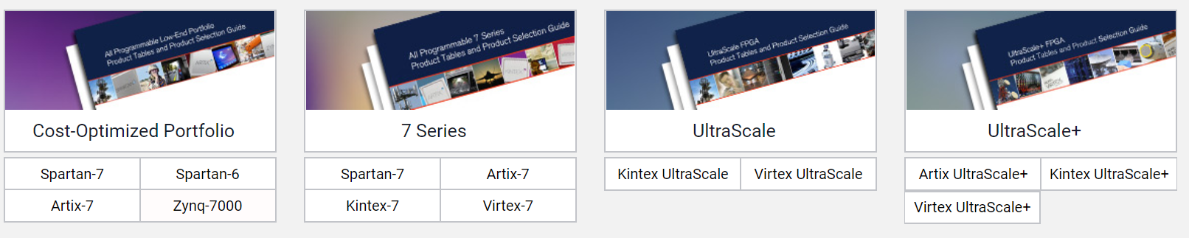
Xilinx Portfolio

Slide 45
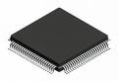
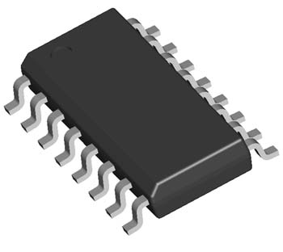
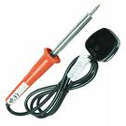
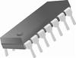
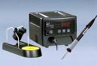
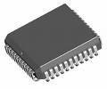
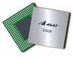
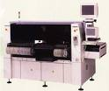
Selection of packages
SOLDERING
IRON
DIP
QFP
SOIC
SOLDERING
STATION
BGA
PLCC
OVEN

Slide 46
Processor selection Criteria
Development tools
Number of I/O’s
Performance
Cost
Operating systems
Hardware tools
Peripherals
Power consumption
Supplier reputation

Slide 47
Tools We will be Learning
Xilinx ISE
Xilinx XPS
Vivado
Python Productivity for ZYNQ

Slide 48
Thank You

